Slide 1
Diseases, Conditions, and Syndromes of the Nervous System

Slide 2
Epilepsy

Slide 3
Grand Mal Siezure

Slide 4
Parkinson’s Disease

Slide 5
Interview with Michael J. Fox

Slide 6
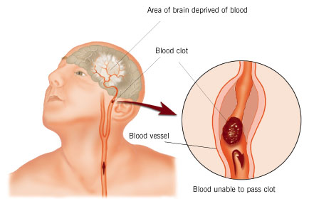
Stroke
Occurs when there is not enough oxygen going to the brain.

Slide 7
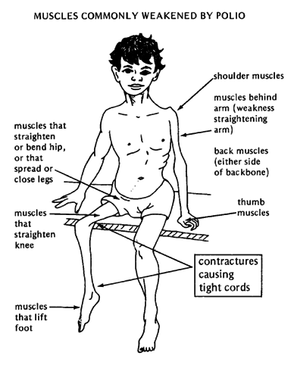
Polio
Viral disease of the central nervous system that can cause paralysis.

Slide 8
Teacher- Collins Syndrome

Slide 9
Juliana Whitmore

Slide 10
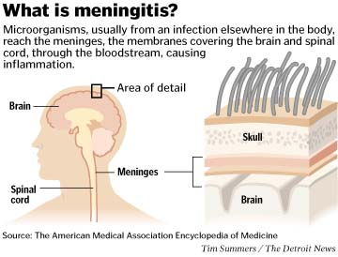
Meningitis
Is an inflammation of the membranes that surround the brain and spinal cord.
Disease is caused by bacteria, or a virus.
Symptoms – Very bad headache

Slide 11
Tourettes Syndrome

Slide 12
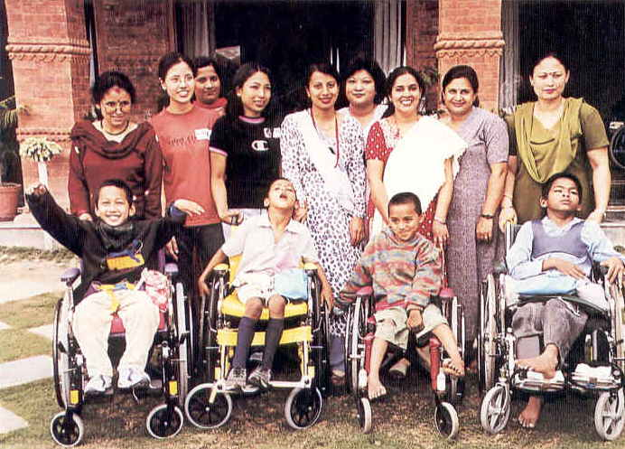
Cerebral Palsy
Congenital disease
(born with)
Disturbance of motor functions

Slide 13
Autism
Overview
Autism is a developmental disorder that appears in the first 3 years of life, and affects the brain's normal development of social and communication skills.
Symptoms
Most parents of autistic children suspect that something is wrong by the time the child is 18 months old and seek help by the time the child is age 2. Children with autism typically have difficulties in:
Pretend play
Social interactions
Verbal and nonverbal communication
Be overly sensitive in sight, hearing, touch, smell, or taste (for example, they may refuse to wear "itchy" clothes and become distressed if they are forced to wear the clothes)
Have unusual distress when routines are changed
Perform repeated body movements
Show unusual attachments to objects

Slide 14
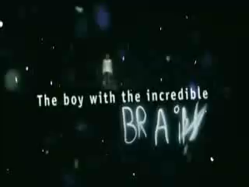

Slide 15
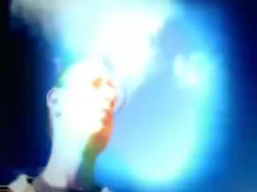

Slide 17
Rainman (Part 1)

Slide 18
Rainman (Part 2)

Slide 19
Kim Peek- the “Real Rainman” 1

Slide 20
Kim Peek- 2

Slide 21
Kim Peek- 3

Slide 22
Kim Peek- 4

